Slide 1
Microbiology Dep.
Second year
Parasitology
third Lec.
Lecturer: Assist prof.
Dr. Sally Ahmed
Phylum: protozoa
Subphylum: Sacromastigophora
Class: Mastigophora
• Characterized by having flagellae in its trophozoite stage, connected to an axonemes and kinetoplast (like brain in human). The microorganism flagellum, an axonemes and kinetoplast performing the neuromotor apparatus. The last one kinetoplast is energizing & the first one is motor part. The kinetoplast formed from the blepharoplast & parabasal body, The blepharoplast either connected together or scattered.
• Some of flagellate is free living, and other are parasitizing arthropods, plants, animal & man.
• The flagellates which parasites human are:
1) Flagellate of digestive tract & urogenital system.
2) Flagellate of blood (Haemoflagellate).

Slide 2
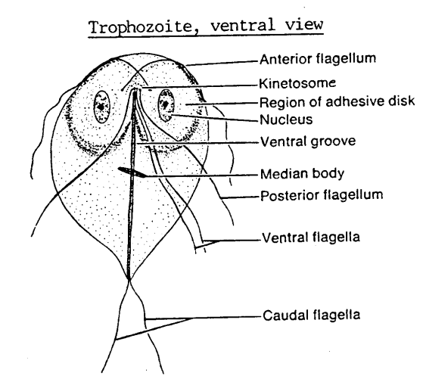
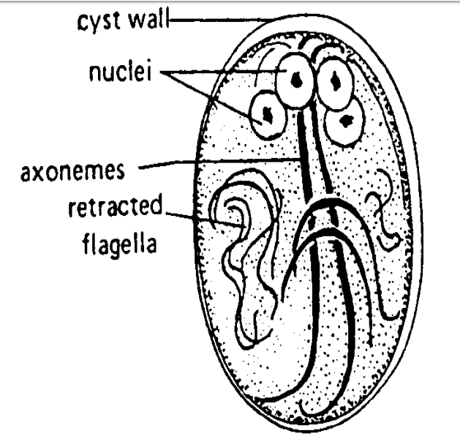
The flagellate of digestive tract & urogenital systems:-
Genus: Giardia
Species: Giardia lamblia
Disease: Giardiasis
Trophozoite, ventral view
Cyst

Slide 3
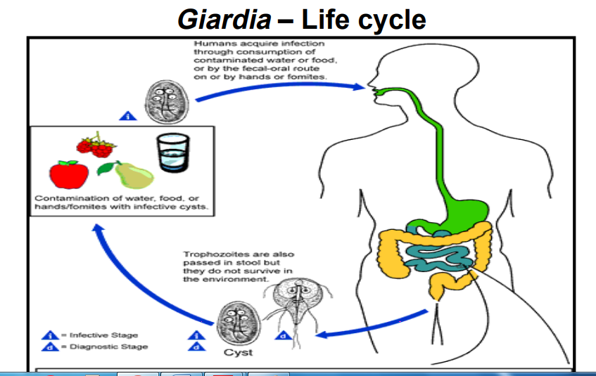
Life cycle:

Slide 4
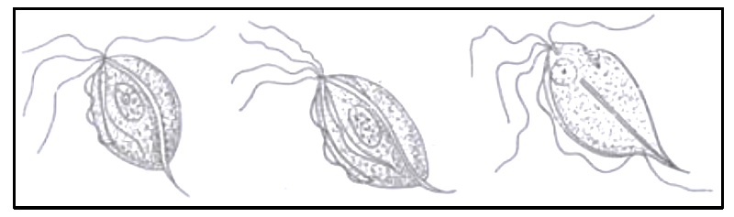
Genus Trichomonas
Trichomonas
• Pear shaped, have a single nucleus, infront the nucleus situated the blepharoplast.
• Most of flagella directed forward & one of them directed backward, and this backward directed flagella forming
undulating membrane, which is a fold of membrane of organism.
It characterized by presence of axostyle, which is semi rigid translucent supported structure.
• There are 3 species adapted to the human host, and only these species contain axostyle.
• There is a cytostome on the lateral side.
Line drawing of the three Trichomonads that parasitized human beings. (1) Trichomonas vaginalis; (2) Trichomonas tenax; (3) Trichomonas hominis.

